Slide 1
Earned value: evm_example
Status as of period 2026-11
Prepared 26 September 2026 with cost-core

Slide 2
Bottom line
• Each dollar spent so far has bought 90 cents' worth of the planned work: the work done has cost 11% over its budget.
• It is 2.2 reporting periods behind schedule, and at this pace finishes around period 35 of a 30-period plan.
• The most likely final cost is about 17,016; plan on 17,151 to be 80% sure. The budget of 15,500 has almost no chance (none of the simulations) of being enough.
• The contractor's estimate of 16,300 has less than a 1% chance of holding, so it is optimistic: it needs the rest of the program to go better than the record so far.
• There is 1 warning sign, on the Warning signs slide; start with it.
• 2 accounts break the variance thresholds and owe a variance analysis report: '1.1 Air vehicle', '1.2 Software'.
17,016
most likely final cost (budget 15,500)
17,151
to be 80% sure of the final cost
35.0
likely finish period (plan: 30)
0.90
CPI: work done per dollar spent
0.84
SPI(t): schedule efficiency
32%
percent complete

Slide 3
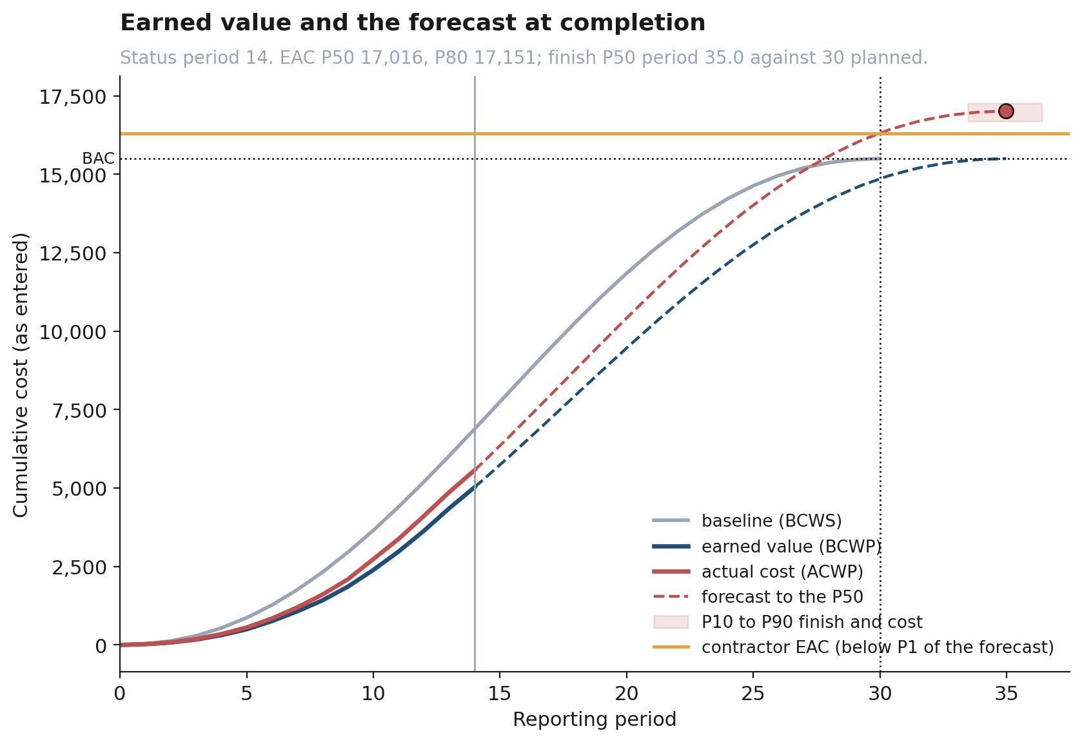
Where the program is heading
Baseline, earned value and actual cost to date, with the P50 forecast and the P10 to P90 range of finish and final cost.

Slide 4
Warning signs
Warning | Why
Contractor EAC below every independent EAC | EAC 16,300.0 against the lowest independent EAC 16,773.4.

Slide 5
Final cost and finish, by confidence
Confidence | Final cost | Finish (period)
P20 | 16,825 | 33.9
P50 | 17,016 | 35.0
P70 | 17,101 | 35.5
P80 | 17,151 | 35.9
P90 | 17,259 | 36.4
Simulated from the program's own period-by-period record.

Slide 6
Accounts owing a variance analysis report
Account | Cost variance | Schedule variance
1.1 Air vehicle | -290 (-10.6%) | -1,257 (-31.4%)
1.2 Software | -162 (-13.1%) | -543 (-30.6%)
Cumulative variance against the thresholds; the Variance reports sheet has the detail.

Slide 7
Control accounts, worst CPI first
Account | CPI | SPI(t) | Cost variance | % complete
1.2 Software | 0.88 | 0.82 | -162 | 31%
1.1 Air vehicle | 0.90 | 0.81 | -290 | 30%
1.3 Systems engineering | 0.92 | 0.97 | -92 | 42%

Slide 8
Assumptions and method
• Drawn from 14 periods of the program's own performance, with persistence 0.90 between periods.
• 20,000 simulated completions, seed 0.
• Every figure and its formula is in report.xlsx beside this briefing.

